Slide 1

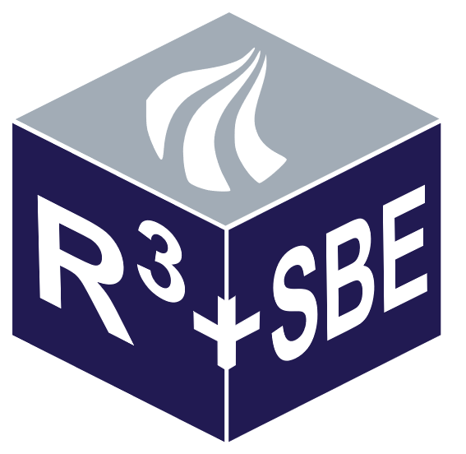

SPECIAL MOBILITY STRAND
On Natural Hazards Risk Management
Michael Havbro Faber
Banja Luka, Bosnia and Herzegovina , December 13, 2018
Michael Havbro Faber,
Department of Civil Engineering, Aalborg University, Denmark

Slide 2
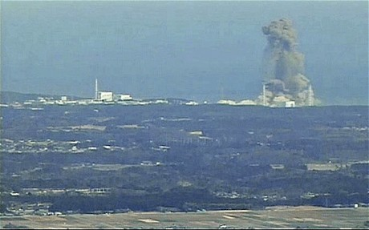
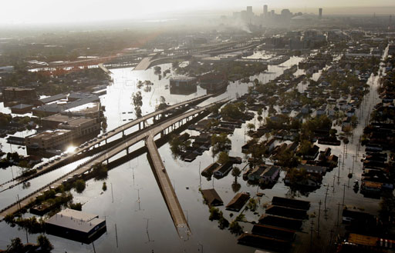
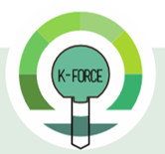
K-FORCE Lectures
Banja Luka
Bosnia and Herzegovina
December 13, 2018
On Natural Hazards Risk Management
Michael Havbro Faber
Department of Civil Engineering
Aalborg University, Denmark

Slide 3
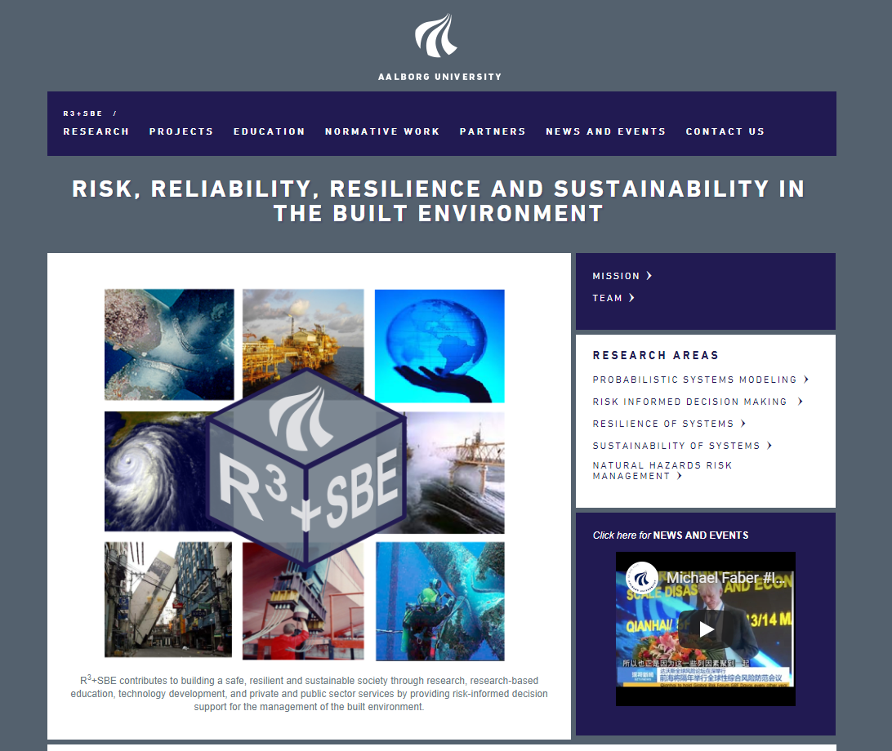
Introduction – My Group at Aalborg University

Slide 4
Introduction – Members of my Team

Slide 5
Introduction – Collaboration Partners

Slide 6
The Challenges of Risk Management
Interrelations of sectors and activities in society
Infrastructures as part of the built environment play a crusial role for the existence and development of society

Slide 7
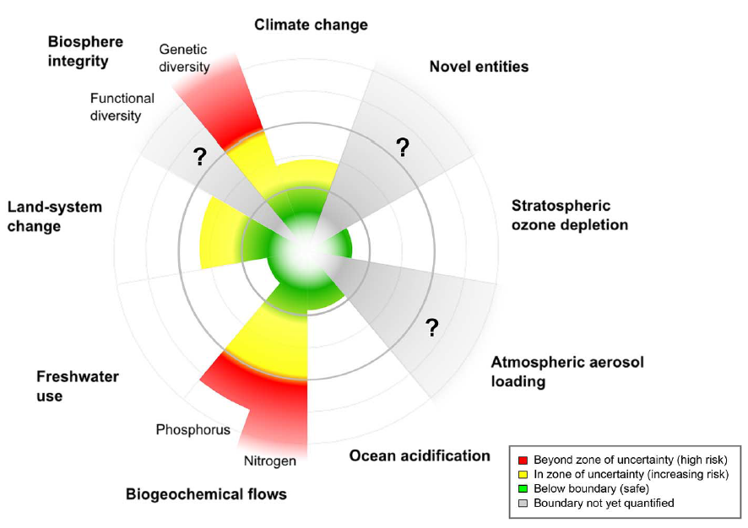
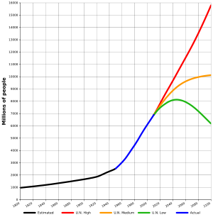
The Challenges of Risk Management
Pressing boundaries for societal developments:
At local and global scales it is increasingly appreciated that societal developments are approaching the limits of the capacities of the ecological systems and the Earth life support system
Population growth, Wikepedia, UN
Planetary boundaries, Steffen et al. 2015^{[1]}

Slide 8
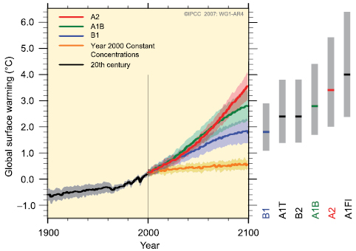
The Challenges of Risk Management
Pressing boundaries for societal developments:
Significant signs of the back-coupling between civilizations and living conditions for civilization are observable
Scenario A2 – heterogeneous world
Scenario B1 – convergent world
CO2 emissions constant at 2000 level
IPCC homepage

Slide 9
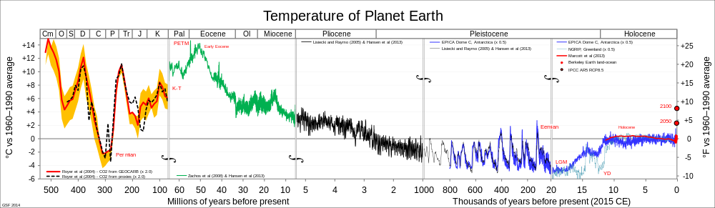
The Challenges of Risk Management
Pressing boundaries for societal developments:
Significant signs of the back coupling between civilizations and living conditions for civilization are observable
Wikepedia
Anthropocene

Slide 10
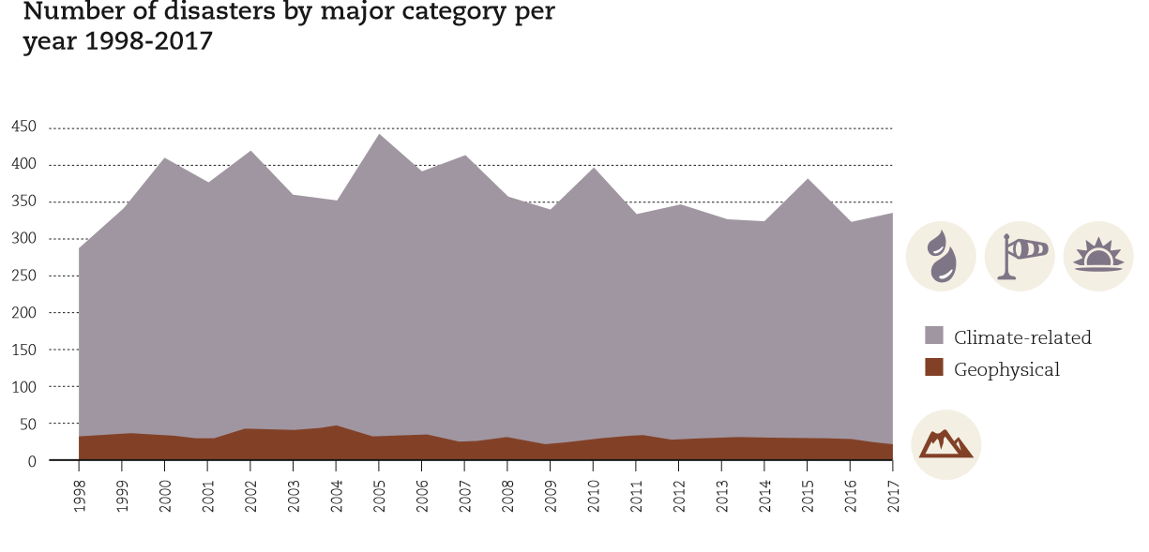
The Challenges of Risk Management
Source: EM-DAT - The OFDA/CRED International Disaster Database.

Slide 11
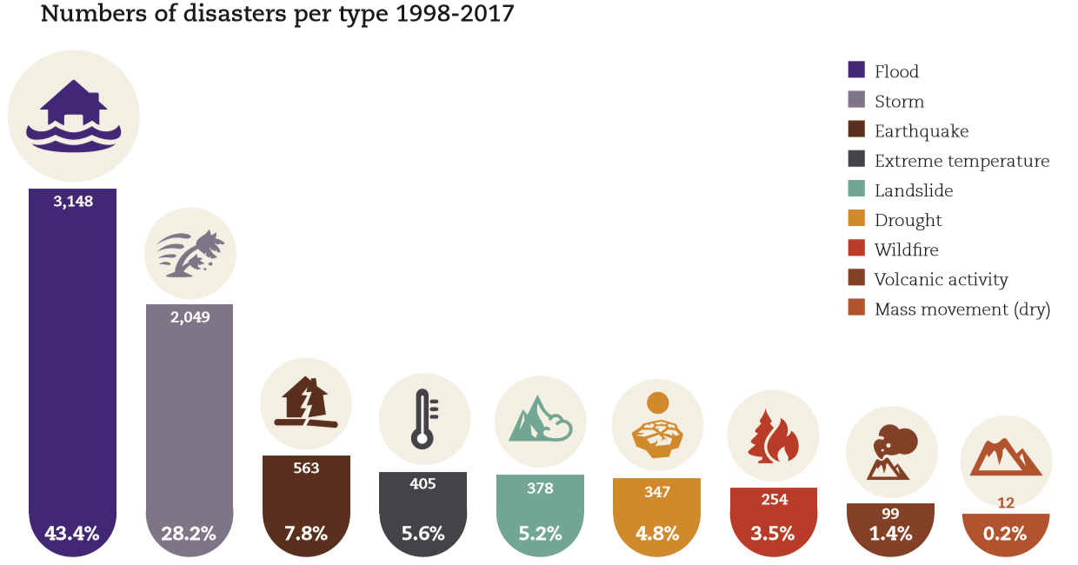
The Challenges of Risk Management
Source: EM-DAT - The OFDA/CRED International Disaster Database.

Slide 12
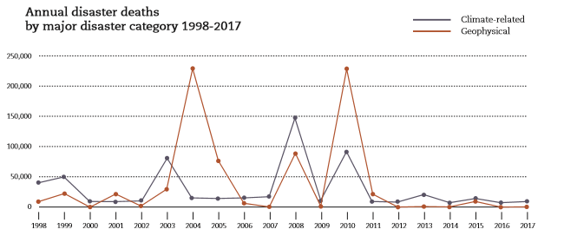
The Challenges of Risk Management
Source: EM-DAT - The OFDA/CRED International Disaster Database.

Slide 13
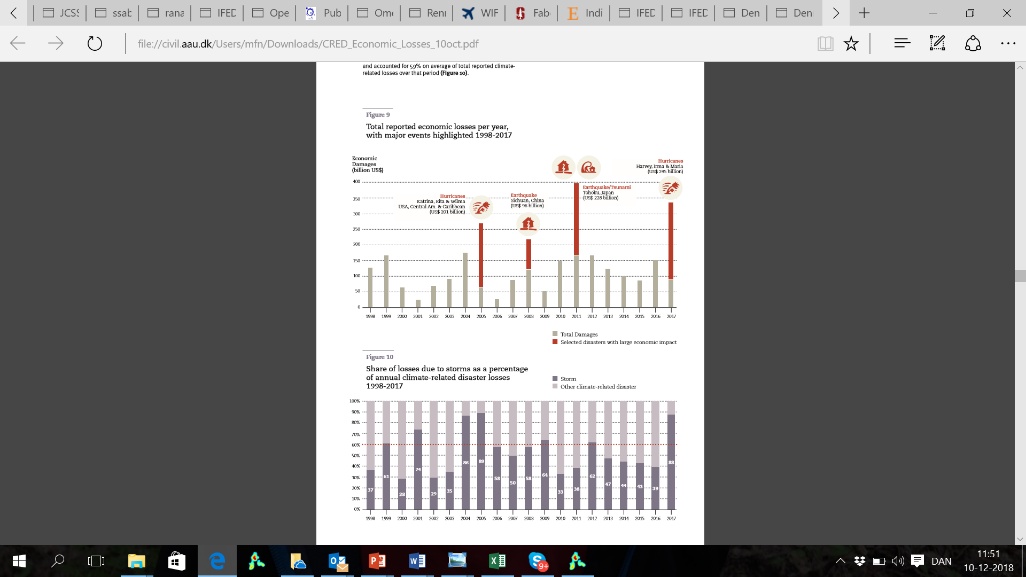
The Challenges of Risk Management
Source: EM-DAT - The OFDA/CRED International Disaster Database.

Slide 14
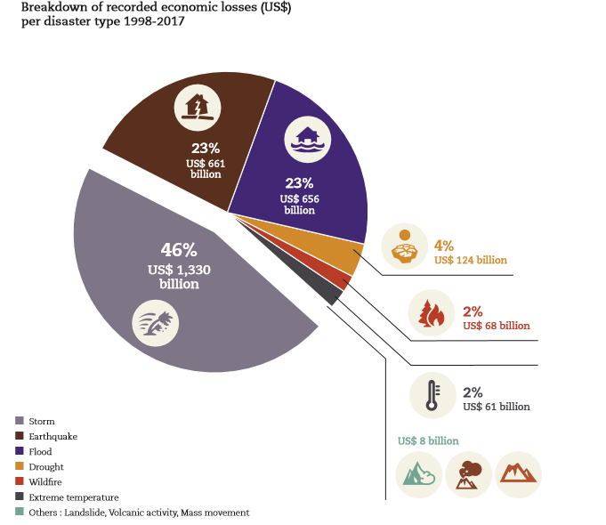
The Challenges of Risk Management
Source: EM-DAT - The OFDA/CRED International Disaster Database.

Slide 15
The Challenges of Risk Management
Source: EM-DAT - The OFDA/CRED International Disaster Database.

Slide 16
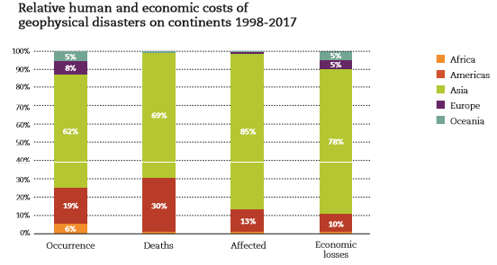
The Challenges of Risk Management
Source: EM-DAT - The OFDA/CRED International Disaster Database.

Slide 17
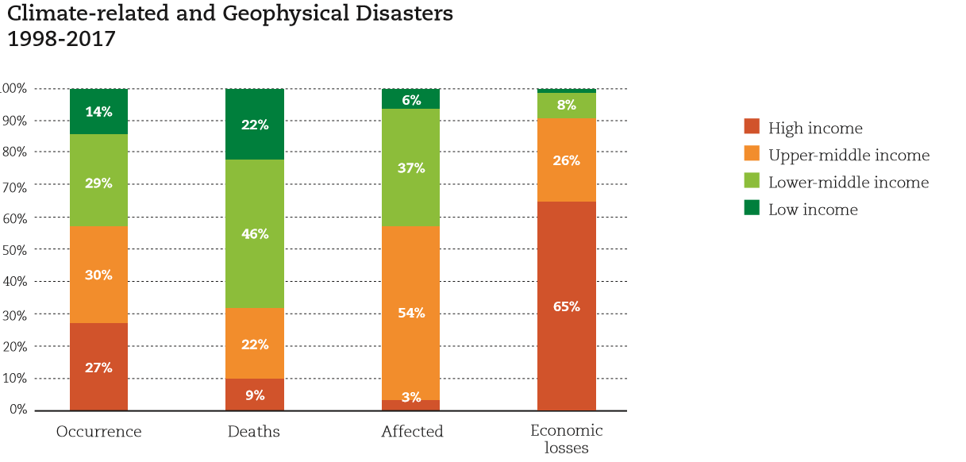
The Challenges of Risk Management
Source: EM-DAT - The OFDA/CRED International Disaster Database.

Slide 18
The Challenges of Risk Management
Infrastructures accommodating 7.5 billion people
Cities in the world (+1 million inhabitants) ~ 500
Bridges in the USA ~ 600.000
Global road network > 13 million km
Global rail network > 1 million km
Airports ~ 50.000
Offshore platforms in the world ~ 6.500
Dams in the world ~ 45.000
Nuclear (civil) reactors in the world ~ 440
……..
……..

Slide 19
The Challenges of Risk Management
Built environment alone
Contributes with ~10% of GDP in Europe
Responsible for 50% of global energy consumption
Concrete responsible for ~8% of global CO2 emissions
Responsible for ~90% of global material consumption (weight)

Slide 20
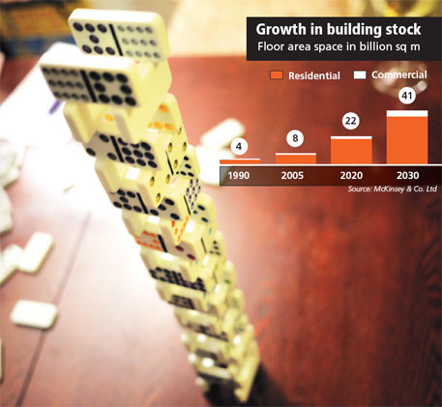
The Challenges of Risk Management
Climate change/sustainability
McKinsey and Co Ltd

Slide 21
The Challenges of Risk Management
Questions to be answered in natural hazards risk management
How to:
- prioritize investments on design and management of
interlinked systems (economy, environment, health)?
- plan and budget for the future (economy, qualities of the
environment, social capacity, health)?
How to assess vulnerability, risks, robustness, resilience and sustainability consistently, which are the criteria to apply for decision making?
How
safe is safe enough
robust is robust enough
resilient is resilient enough
sustainable is sustainable enough
?

Slide 22
Contents of Presentation
Resilience/sustainability – definitions and insights
Decision Support Framework
Probabilistic systems representation
- Vulnerability and risks of systems
- Robustness of systems
- Resilience of systems
- Consequences to health and environment
- Sustainability of systems
Examples
Conclusions and outlook

Slide 23
Resilience/sustainability – Definitions and Insights
Resilience (definitions):
Pimm (1984) - Resilience….the time it takes till a system which has been subjected to a disturbance returns to its original mode and level of functionality
Holling (1996) - Resilience.…the measure of disturbance which can be sustained by a system before it shifts from one equilibrium to another
Cutter (2010) - Resilience…. capacity of a community to recover from disturbances by their own means
Bruneau (2009) – Resilience…. a quality inherent in the infrastructure and built environment; by means of redundancy, robustness, resourcefulness and rapidity
National Academy of Science (NAS, USA) - Resilience….a systems ability to plan for, recover from and adapt to adverse events over time

Slide 24
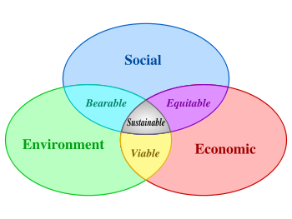
Resilience/sustainability – Definitions and Insights
Sustainability:
Gro Harlin Bruntland report (1987) – Our Common Future
“Humanity has the ability to make development sustainable to ensure that it meets the needs of the present without compromising the ability of future generations to meet their own needs”

Slide 25
Resilience/sustainability – Definitions and Insights
Sustainability (environment):
Kates et al.(2001) recommends to explore and assess the relation between resilience and sustainability and propose to utilize decision support systems as a means to identify sustainable paths of societal developments
Steffen et al. (2015) introduce the concept of Planetary Boundaries as a concept for representing the capacities of the Earth System (Earth Life Support System - ELSS)
Hauschild (2015) suggests to utilize quantitative sustainability assessments to assess the aggregate impacts of human activities at global level with respect to the main parameters controlling safe operating conditions (ELSS) for the planetary system.

Slide 26
Resilience/sustainability – Definitions and Insights
Strategies for sustainable and resilient systems
Efficiency/optimality
Diversity
Redundancy
Robustness
Temporally optimized solutions
Planned and smart renewals
Options for buying information and changing strategies
Additional data collection, monitoring and control
Optimal balance between efficiency and resilience
Joint consideration of efficiency/sustainability, resilience, safety, economy and welfare

Slide 27
Decision Support Framework
Hierarchies of societal management

Slide 28
Decision Support Framework
The general framework (traditional)

Slide 29
Decision Support Framework
The general framework (new direction)
The general framework (enhanced)

Slide 30
Probabilistic System Representation
Interlinked systems

Slide 31
Probabilistic System Representation
Risk aggregation - portfolio risk modeling

Slide 32
Probabilistic System Representation
Hazards and disturbances
Type 1: “Large scale averaging events”
- low probability/high consequences
Type 2: “Seepage events”
- high probability/low consequences
Type 3: “Non-averaging events”
- low probability/extreme consequences
Type 4: ”Information condition”
- as for Type 1-3

Slide 33
Probabilistic System Representation
Information condition

Slide 34
Probabilistic System Representation
Information condition
The information is relevant and precise.
The information is relevant but imprecise.
The information is irrelevant.
The information is relevant but incorrect.
The flow of information is disrupted or delayed.

Slide 35
Probabilistic System Representation
Direct and indirect consequences

Slide 36
Probabilistic System Representation
Vulnerability and risk modelling
It is assumed that all relevant scenarios
have been identified

Slide 37
Probabilistic System Representation
Robustness modeling
It is assumed that all relevant scenarios
have been identified

Slide 38
Probabilistic System Representation
Probabilistic resilience modeling

Slide 39
Probabilistic System Representation
Probabilistic resilience modeling
Robustness

Slide 40
Probabilistic System Representation
Probabilistic resilience modeling
Preparedness,
adaptive capasity
Robustness
Faber M. Risk Informed Structural Systems
Integrity Management: A Decision Analytical
Perspective. ASME. International Conference on
Offshore Mechanics and Arctic Engineering,
Volume 9: Offshore Geotechnics; Torgeir Moan
Honoring Symposium ():V009T12A040.
doi:10.1115/OMAE2017-62715.

Slide 41
Probabilistic System Representation
Resilience modeling
Faber M.H., Qin J., Miraglia S. and Thöns S. (2017).
On the Probabilistic Characterization of Robustness and
Resilience”, Procedia Engineering 198 ( 2017 ) 1070 – 1083.

Slide 42
Probabilistic System Representation
Consequences to health, environment and economy
Impacts to health and safety are addressed through the relative utility function comprised by the Life Quality Index (LQI) (Nathwani et al, 1997)
Impacts to the environment are addressed through:
- Quantitative Life Cycle Analysis (substances/energy)
(Hauschild, 2015)
Impacts to the economy are addressed through:
- Monetary benefits (production functions)
- Monetary losses (production functions)

Slide 43
Probabilistic System Representation
Sustainability modeling
Global Planetary Boundaries provide a means for allocating capacities to different societal activities
Global capacities
Local /national and sector wise allocation of capacities
- Built environment
- Energy production and distribution
- Food production
- Transportation
- .....
- ....
- ...
- ..

Slide 44
Probabilistic System Representation

Slide 45
Probabilistic System Representation
Sustainability modeling
For given sector, geographical area or project sustainability failure is expressed in terms of exceedance of Planetary Boundaries

Slide 46
Probabilistic System Representation
Overall framework

Slide 47
Example Illustrations
Application of modeling concept
- Rock-Fall
- Typhoons
Exposure
Exposure
Vulnerability
Vulnerability
Direct consequences
Direct consequences
Robustness
Robustness
Indirect consequences
Indirect consequences
Earthquake risk
management

Slide 48
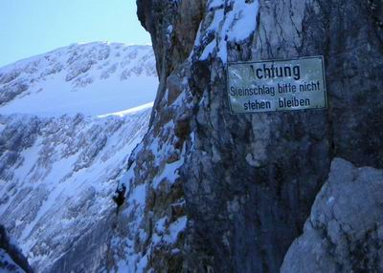
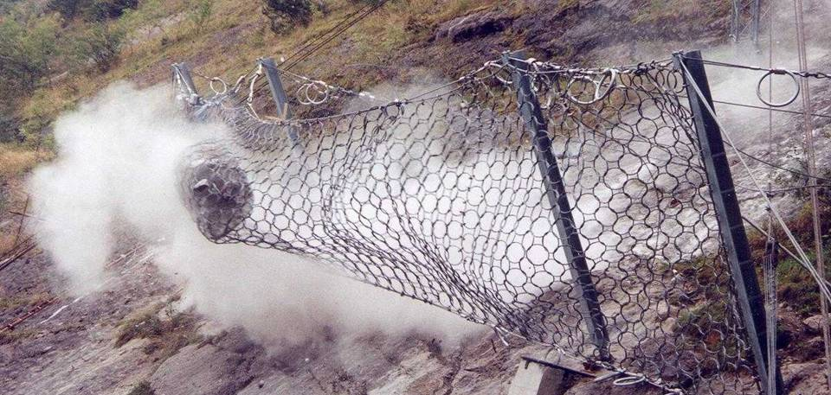
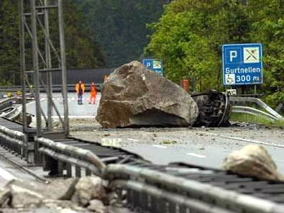
Exposure Modeling
Exposure analysis in regard to rock-fall

Slide 49
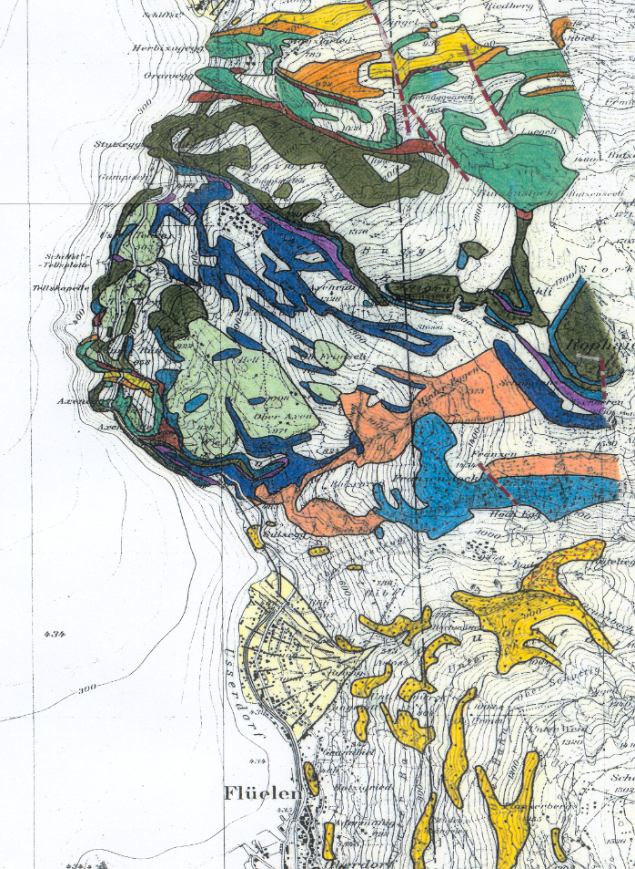
Exposure Modeling
Exposure analysis in regard to rock-fall

Slide 50
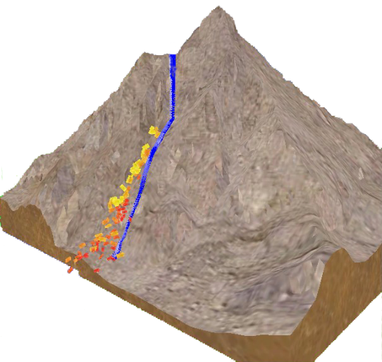
Exposure Modeling
Exposure analysis in regard to rock-fall

Slide 51
Exposure Modeling
Exposure analysis in regard to rock-fall
Detachment modeling
Fall modeling

Slide 52
Typhoon Exposure Modeling
Representing the Event of Typhoons
Notes:
52

Slide 53
Typhoon Exposure Modeling
Representing the Event of Typhoons
Notes:
53

Slide 54
Typhoon Exposure Modeling
Representing the Event of Typhoons
Notes:
54

Slide 55
Management of Risks due to Earthquakes
Large scale earthquake risk management

Slide 56
Management of Risks due to Earthquakes
Risk assessment for large portfolios

Slide 57
Management of Risks due to Earthquakes
Large scale earthquake risk management

Slide 58
Recent Developments in Systems Modeling
Large scale earthquake risk management

Slide 59
Recent Developments in Systems Modeling
Large scale earthquake risk management

Slide 60
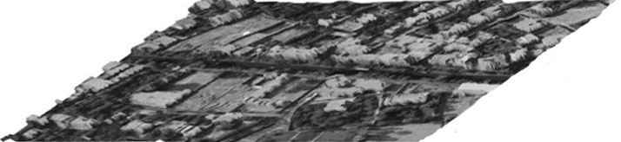
Recent Developments in Systems Modeling
Large scale earthquake risk management
Str. Classes
Aerial Photo
Soil Types
Seismicity

Slide 61
Recent Developments in Systems Modeling
Large scale earthquake risk management
Opt. Decision
Indirect Risk
Direct Risk
Str. Damages

Slide 62
Recent Developments in Systems Modeling
Large scale earthquake risk management
Liquifaction

Slide 63
Recent Developments in Systems Modeling
Large scale earthquake risk management
Condition indicators for
liquefaction susceptibility
of silty and sandy soils

Slide 64
Recent Developments in Systems Modeling
Large scale earthquake risk management
Vulnerability
in regard to
liquifaction
Locations of buildings and
soil measurements

Slide 65
Recent Developments in Systems Modeling
Large scale earthquake risk management
Vulnerability
in regard to
liquifaction

Slide 66
Recent Developments in Systems Modeling
Large scale earthquake risk management
Mean and coefficient of variation of conditional Standard Penetration Test (SPT)
blowcounts (N₁)₆₀ simulations
(N₁)₆₀ is the SPT blow count normalized to an overburden
pressure of approximately 100 kPa and a hammer energy ratio of 60%.

Slide 67
Recent Developments in Systems Modeling
Large scale earthquake risk management
Probability of liquefaction at the study site,
given a M=7.5 earthquake causing a PGA of 0.3g

Slide 68
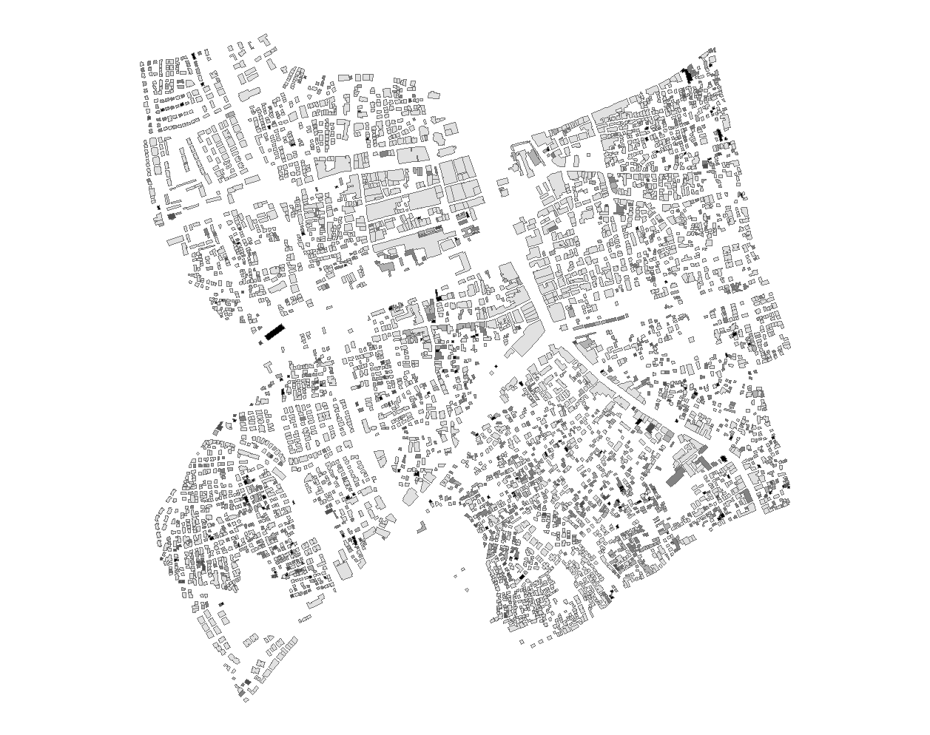
Recent Developments in Systems Modeling
Large scale earthquake risk management
Distribution of damage for a
M=7.5 earthquake

Slide 69
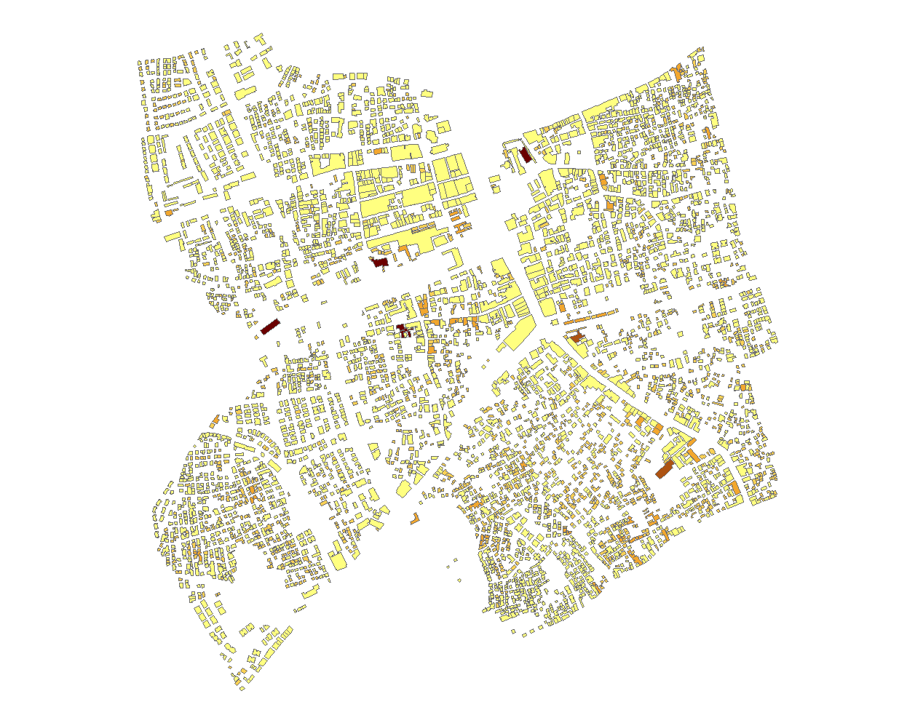
Recent Developments in Systems Modeling
Large scale earthquake risk management
Total risks for a
M=7.5 earthquake

Slide 70
Management of Risks due to Earthquakes
Risk assessment for large portfolios

Slide 71
Management of Risks due to Earthquakes
Risk assessment for large portfolios
Without dependency
With dependency

Slide 72
Management of Risks due to Earthquakes
Risk assessment for large portfolios

Slide 73
Concluding Remarks
Modern risk assessment frameworks and tools greatly enhance risk management
Utilize generic risk modeling
Facilitate updating of risks through indicators
Can be applied for individually and jointly acting hazards
Can be coupled with any (set) of models available which link exposure events to effects of climatic change

Slide 74
Concluding Remarks
We still need to improve modelling and best practices in risk management of natural hazards to establish the right focus on how to:
- reduce risks
- increase resilience
- achieve sustainability
Efforts must be directed on standardization of:
- modeling approaches
- assessment criteria
Industry 4.0 must be utilized to facilitate:
- open platforms for sharing models/data/tools
- real-time observations/monitoring/advise

Slide 75
K-FORCE Lectures
Banja Luka, Bosnia Herzegovina
December 13, 2018
Thanks for your attention ☺
mfn@civil.aau.dk
www.r3sbe.civil.aau.dk

